Slide 1


Green Pace
Security Policy Presentation
Developer: Ryan McFarland

Slide 2

OVERVIEW: DEFENSE IN DEPTH

Slide 3
THREATS MATRIX
Likely STD-002-CPP STD-003-CPP STD-004-CPP STD-005-CPP | Priority STD-001-CPP STD-002-CPP STD-003-CPP STD-004-CPP STD-005-CPP
Low Priority STD-006-CPP STD-007-CPP | Unlikely STD-001-CPP STD-006-CPP STD-010-CPP

Slide 4
10 PRINCIPLES
Validate Input Data
STD-001-CPP, STD-002-CPP, STD-003-CPP, STD-004-CPP, STD-007-CPP, STD-008-CPP, STD-010-CPP
Heed Compiler warnings
STD-002-CPP, STD-003-CPP, STD-008-CPP, STD-009-CPP
Architect and Design for Security Policies
STD-003-CPP, STD-006-CPP, STD-007-CPP, STD-008-CPP, STD-009-CPP, STD-010-CPP
Keep It Simple
STD-003-CPP, STD-004-CPP, STD-005-CPP, STD-006-CPP, STD-007-CPP, STD-008-CPP, STD-009-CPP, STD-010-CPP
Default Deny
STD-008-CPP
Adhere to the Principle of Least Privilege
STD-006-CPP, STD-009-CPP, STD-010-CPP
Sanitize data Sent to Other Systems
STD-004-CPP, STD-010-CPP
Practice Defense in Depth
STD-004-CPP, STD-005-CPP, STD-006-CPP, STD-007-CPP, STD-008-CPP, STD-009-CPP
Use Effective Quality Assurance Techniques
STD-009-CPP, STD-010-CPP
Adopt a Secure Coding Standard
STD-009-CPP, STD-010-CPP

Slide 5
CODING STANDARDS
Ensure that unsigned integer operations do not wrap.
Ensure that operations on signed integers do not result in overflow.
Guarantee that storage for strings has sufficient space for character data and the null terminator.
Utilize parameters over raw string queries to access data sources.
Do not access freed memory.
Do not use assertions in production code.
Handle all exceptions.
Use valid iterator ranges.
Do not call system().
Do not use std::rand() for generating pseudorandom numbers.

Slide 6
ENCRYPTION POLICIES
Encryption in rest
Stored passwords and similar must be stored in a secure manner. Data must be encrypted so that unauthorized access is less likely to result in useable data for the perpetrators. Encryption schemes will change as technology changes. Schemes that result in significant delays to access data are appropriate if data will not be accessed routinely.
Encryption at flight
Communications must be conducted in a secure manner starting with methods to confirm the recipient identity. Information sent must be obfuscated sufficiently to prevent successful interception of data in transit by those not privy.
Encryption in use
Data in use will be obfuscated whenever feasible. Data used heavily will be encrypted while at rest and unencrypted during use with an eye toward using schemes that allow for faster retrieval. Speed will not be achieved at the expense of effective encryption.

Slide 7
TRIPLE-A POLICIES
Authentication
Identifying a user. This applies because it is necessary to identify users in order to administer an effective security policy. This typically occurs during a login process of some sort which could be as simple as remembering which devices are registered by the user.
Authorization
After being identified the user identity will determine what authorization is conferred upon the user. When appropriate this may be determined by attributes such as the user location, device, or some similar data. Authorization may also be determined on a case-by-case basis.
Accounting
Accounting is the act of logging every transaction. These transactions may need to be scrutinized further to establish whether malicious activity has occurred within a system. If poor accounting has taken place this will make it difficult to determine root cause for security events. Accounting must log all system activity to be effective. This logging should include information such as files accessed by users.

Slide 8
Unit Testing
The following will provide an example of unit testing with gtest to achieve compliance. These tests are examples.

Slide 9
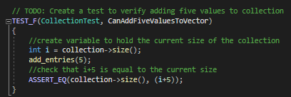
Unit Testing
CanAddFiveValuesToVector:

Slide 10
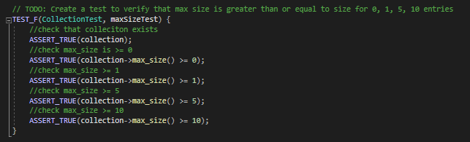
Unit Testing
maxSizeTest:

Slide 11
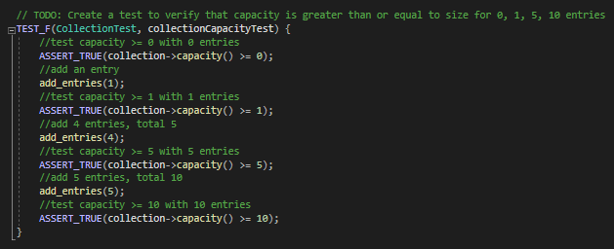
Unit Testing
collectionCapacityTest:

Slide 12
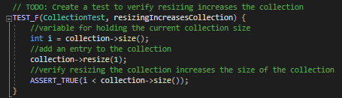
Unit Testing
resizingIncreasesCollection:

Slide 13

AUTOMATION SUMMARY

Slide 14
TOOLS
Assess and Plan
Design
Test Driven Development
Build
Verify and Test
Vulnerability Scanning
Transition and Health Check
Automated Penetration Testing
Monitor and Detect
Logs
Event Alerts
Respond
Automated Response
Maintain and Stabilize
Return to Baseline

Slide 15
RISKS AND BENEFITS
Currently Proposed Plan
Use automation throughout to reduce time requirements
Risks
Automation is fallible
Steps
Proficiency in testing and static analysis tools
Adherence to coding standards and principles

Slide 16
RECOMMENDATIONS
Automate
Follow standards
Test code and defenses
Review effectiveness of standards and processes
Revise standards and processes as needed

Slide 17
REFERENCES
Carnegie Mellon University. (2020). SEI CERT C++ Coding Standard. Retrieved from Carnegie Mellon University : https://wiki.sei.cmu.edu/confluence/pages/viewpage.action?pageId=88046682
Cprogramming.com. (2019). XOR Encryption in C++. Retrieved from Cprogramming.com: https://www.cprogramming.com/tutorial/xor.html
Google. (2022). DevOps tech: Shifting left on security. Retrieved from Google Cloud: https://cloud.google.com/architecture/devops/devops-tech-shifting-left-on-security

